Slide 1
Acoustics
COMP.SGN.120
Introduction to Audio processing
Lecture 2

Slide 2
Vibrating systems
Recap …
Sound: produced by some mechanical vibration or a rapid modulation of air flow.
Medium: air, water, …
Source: speech organs, vibrating plates, column of a guitar body, diaphragm of a loudspeaker, …
Those oscillations of the pressure are called Sound waves.
Some characteristics:
Alternating of potential and kinetic energy.
Motion repeats in regular time intervals.
System back to equilibrium by some force.

Slide 3
Oscillation
In sound waves:
The air molecules oscillate back and forth in the longitudinal direction
(in which the sound is travelling).
We need to understand oscillation to understand waves.
Properties of oscillations
Frequency: number of oscillations per unit of time.
Amplitude: maximum displacement from its central position.
Time period: time needed to complete an oscillation.

Slide 4
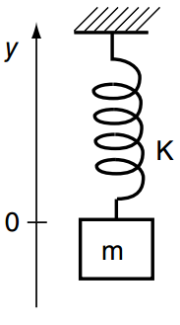
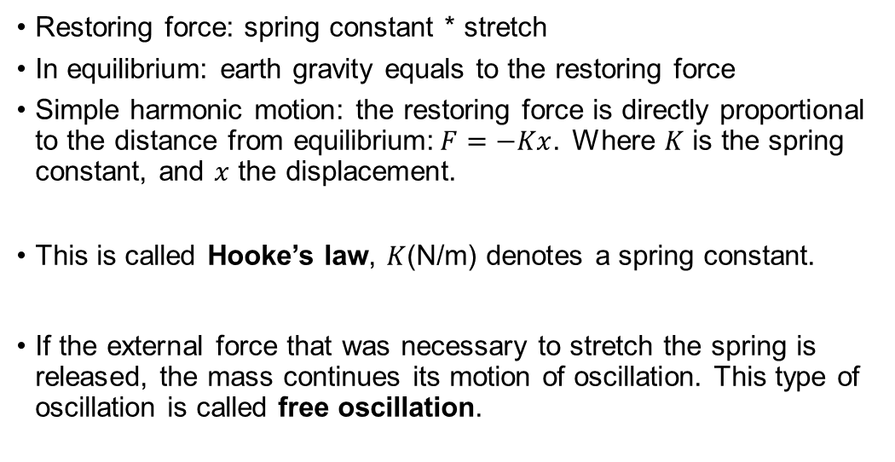
A simple vibrating system
Restoring force: spring constant * stretch
In equilibrium: earth gravity equals to the restoring force
Simple harmonic motion: the restoring force is directly proportional to the distance from equilibrium:$F=−Kx$. Where $K$ is the spring constant, and $x$ the displacement.
This is called Hooke’s law, $K$(N/m) denotes a spring constant.
If the external force that was necessary to stretch the spring is released, the mass continues its motion of oscillation. This type of oscillation is called free oscillation.
Spring-mass system

Slide 5
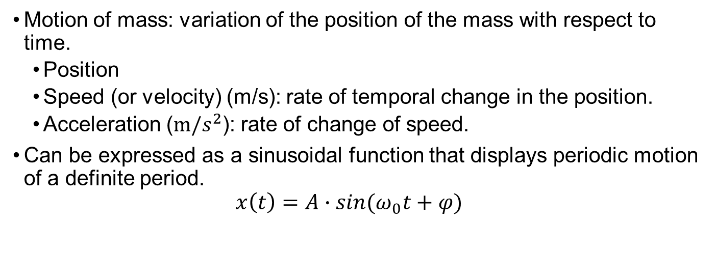
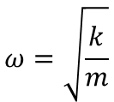
Free oscillation
Motion of mass: variation of the position of the mass with respect to time.
Position
Speed (or velocity) (m/s): rate of temporal change in the position.
Acceleration ($m/s^{2}$): rate of change of speed.
Can be expressed as a sinusoidal function that displays periodic motion of a definite period.
$$x\left(t\right)=A∙sin(ω_{0}t+φ)$$
$$ω=\sqrt{\frac{k}{m}}$$
A is amplitude, maximum displacement
𝜔 is angular frequency, 𝜔=2𝜋f,
t is time, 𝜑 is phase

Slide 6
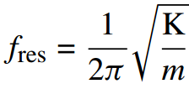
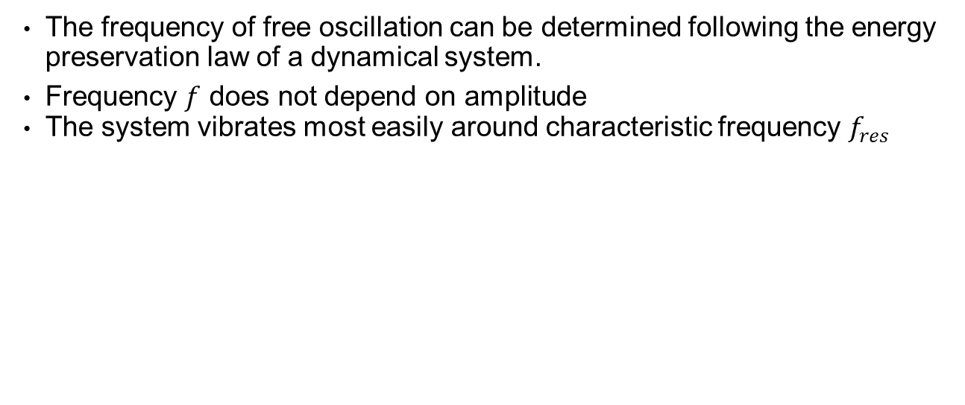
Frequency of free oscillation
The frequency of free oscillation can be determined following the energy preservation law of a dynamical system.
Frequency $f$ does not depend on amplitude
The system vibrates most easily around characteristic frequency $f_{res}$
A sinusoidal function is a periodic function that can be expressed by a single frequency.
Mass-spring system = simple oscillator

Slide 7
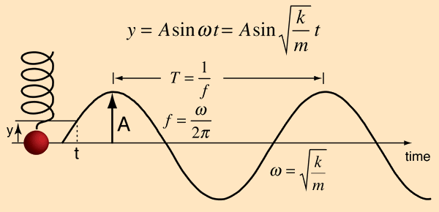
Simple harmonic motion (SHM)
Examples:
Pendulum in the clocks
Swing
Car shock absorber
Musical instruments
Bungee jumping
Hearing

Slide 8
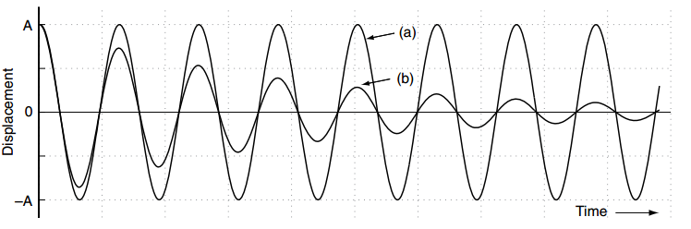
Free vibration and damping
In practice, there is an energy loss, so the amplitude of the oscillation decreases exponentially in time.
From: Pulkki, Karjalainen, Communication Acoustics: An Introduction to Speech, Audio and Psychoacoustics
This is because energy exchange between potential and kinetic energy does not last for long due to a loss of dynamical energy.

Slide 9
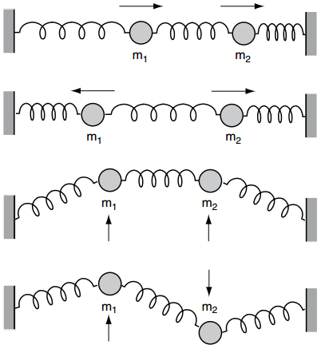
Two-mass system
Multiple masses create more complicated oscillations
Two masses with two degrees of freedom:
Longitudinal vibration:
horizontal, in direction of coupling
masses moving into same or opposite directions
e.g. air column in wind instrument
Transversal vibration:
perpendicular to direction of coupling
e.g. membrane of a drum
From: Pulkki, Karjalainen, Communication Acoustics: An Introduction to Speech, Audio and Psychoacoustics

Slide 10
Vibrating objects
Vibrating object is the source of the disturbance that moves through the medium.
Hit
Struck
Plucked
strummed
Vocal cords
String of a guitar
Vibrating tines of a tuning fork
Each object tends to vibrate at a particular frequency or frequencies known as the natural frequency.
Flute produces a pure tone, vibrates at a single frequency.
Tuba vibrates at a set of frequencies, produces a rich tone.

Slide 11
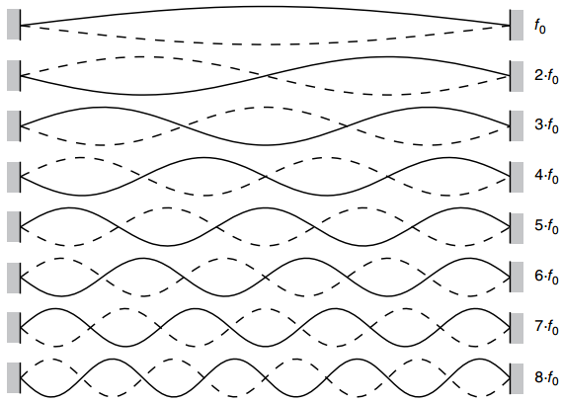
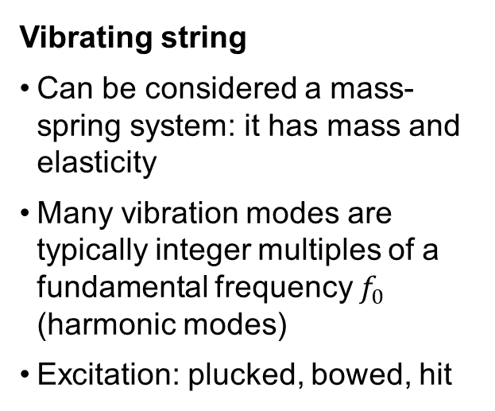
Vibration in musical instruments
Vibrating string
Can be considered a mass-spring system: it has mass and elasticity
Many vibration modes are typically integer multiples of a fundamental frequency $f_{0}$ (harmonic modes)
Excitation: plucked, bowed, hit
Check Vibrational Modes of Continuous Systems at https://www.acs.psu.edu/drussell/demos.html
From: Pulkki, Karjalainen, Communication Acoustics: An Introduction to Speech, Audio and Psychoacoustics

Slide 12
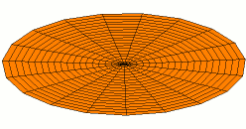
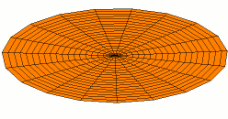
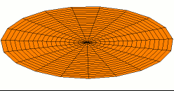
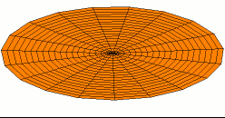
Vibration in musical instruments
Circular membrane
“Two-dimensional” spring, tension acts as restoring force
Vibration modes not harmonic
Animation of four vibration modes (source wikipedia)
The vibrating modes can be aligned properly to form a quasi-harmonic series.

Slide 13
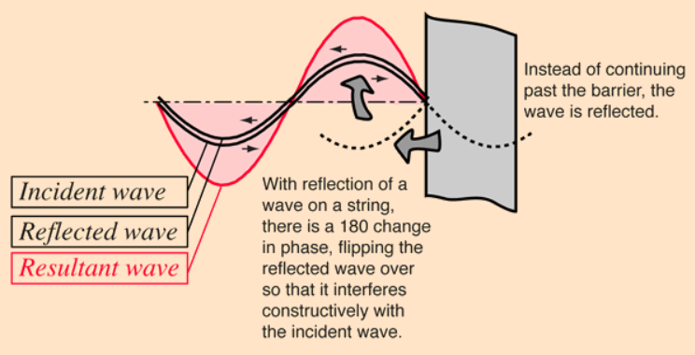
Vibration in musical instruments
Air-filled pipes
Vibrating air column
Comparable to a vibrating string, many vibration modes
Example: clarinet
The tubing in a wind instrument confines the motion of the air inside it, the air particles must wiggle parallel to the walls of the pipe.

Slide 14
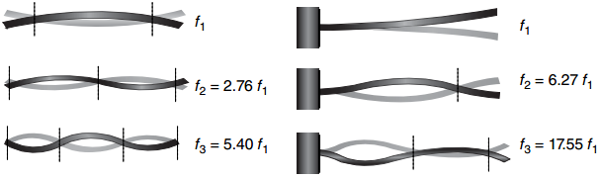
Vibration in musical instruments
Vibrating bar
Stiffness of the bar is restoring force
The vibrational frequency depends on the stiffness of the bar
Vibration modes not harmonic
Examples: marimba, xylophone, glockenspiel
From: Pulkki, Karjalainen, Communication Acoustics: An Introduction to Speech, Audio and Psychoacoustics

Slide 15
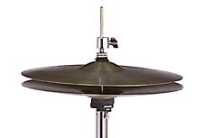
Vibration in musical instruments
Vibrating plate
Stiffness of the plate acts as restoring force
Vibrational modes are not harmonics.
Example: cymbal, high-hat cymbal
Some articles published in The Journal of the Acoustical society of America:
“Vibration of symbals, gongs and tamtams”
“Modes of vibration and decay times in cymbals”

Slide 16
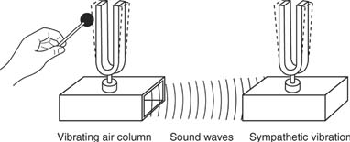
Sympathetic vibration
The amount of sound radiated by a source is proportional to the amount of air it displaces as it moves (string vs drum)
Radiation can be increased by attaching the vibrating system to a wood plate
Plate moves providing more radiating energy
Musical instruments contain more vibrators working together
Piano string and soundboard
Guitar strings and guitar body
Clarinet reed and column of air
Sympathetic vibration of the sounding box/plate
The sounding box also has resonance frequencies and determine the timbre of the instrument

Slide 17
In which medium sound travels the fastest?
Liquid
Solid
Vacuum
Gaseous

Slide 18
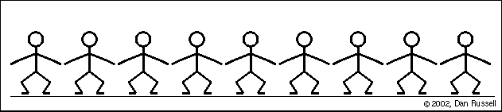
Waves

Slide 19
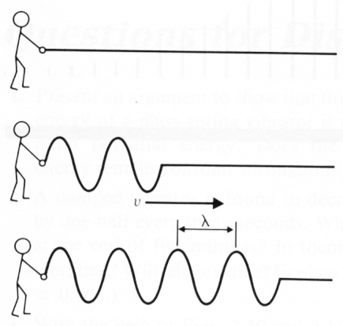
Progressing waves
Waves transport energy and information through a medium
The medium itself is not transported!
For sound the medium is usually air
Speed of sound in air: approx. 343 m/s (at 20 ℃)
For temperature t in ℃, v = 331.3 + 0.6 t
Progressing wave: e.g. a wave in a rope
v = fλ
v – velocity
f – frequency
λ - wavelength

Slide 20
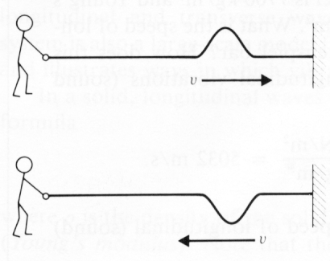
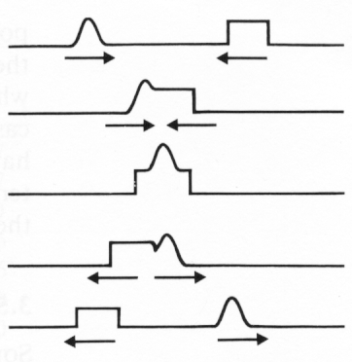
Properties of waves
Reflection:
Discontinuity of the medium causes a reflection
Rope: phase is reversed from tied end, not reversed from loose end
See https://www.acs.psu.edu/drussell/Demos/reflect/reflect.html
Linear superposition
Waves may travel “through“ each other without changing their properties
See https://www.acs.psu.edu/drussell/Demos/superposition/superposition.html

Slide 21
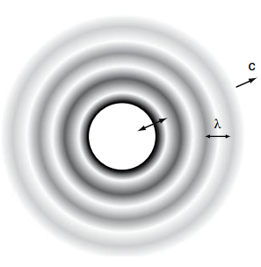
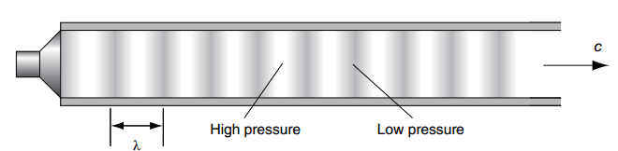
Propagation
Sound waves propagate in two or three dimensions
Sources with different geometries have different patterns:
Spherical waves: point source (spherical in practice)
Plane waves: in a tube
Sound speed is faster in water than in air because of the difference of the elastic properties.

Slide 22

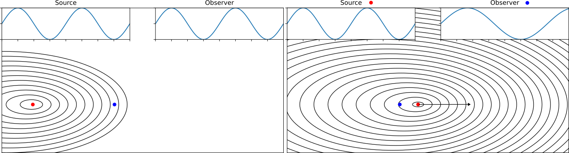
Doppler effect
When the distance between source and observer changes, each successive wave is emitted from a different position.
The time between arrival of successive waves to the observer changes → change in frequency!
source moves towards observer → decreased frequency
See here [demos]

Slide 23
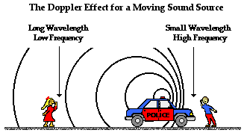
Doppler effect
The doppler effect alters the observer frequency, due to the motion of the source.
Since the observer is still, and the source is travelling away from it, the emitted waves must travel additional distance to reach the observer.

Slide 24
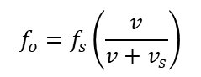
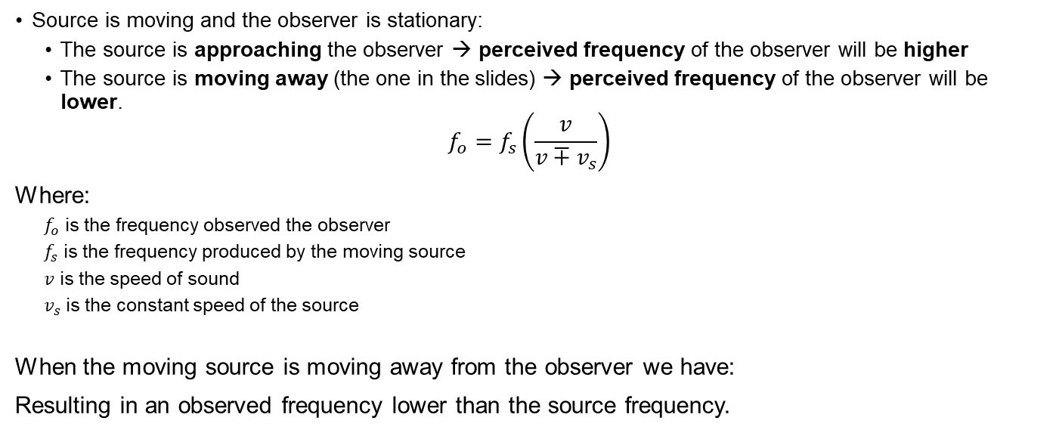
Doppler effect
Source is moving and the observer is stationary:
The source is approaching the observer → perceived frequency of the observer will be higher
The source is moving away (the one in the slides) → perceived frequency of the observer will be lower.
$$f_{o}=f_{s}\left(\frac{v}{v∓v_{s}}\right)$$
Where:
$f_{o}$ is the frequency observed the observer
$f_{s}$ is the frequency produced by the moving source
𝑣 is the speed of sound
$v_{s}$ is the constant speed of the source
When the moving source is moving away from the observer we have:
Resulting in an observed frequency lower than the source frequency.
$$f_{o}=f_{s}\left(\frac{v}{v+v_{s}}\right)$$

Slide 25
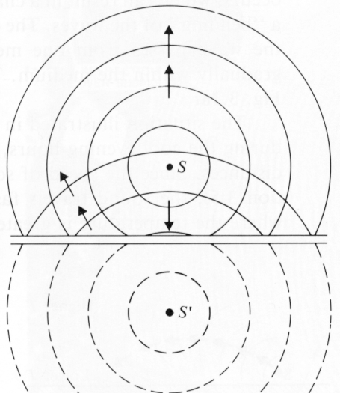
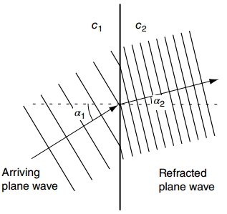
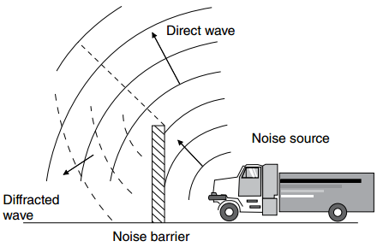
Reflection, refraction, diffraction
Reflection: clapping hands at some distance from a wall.
Reflected waves come from an imaginary source behind the reflecting surface (mirrored!)
Refraction: wavefront bends when entering a different medium (speed of wave changes). Direction of the wave changes, frequency remains the same
Diffraction: sound bends around obstacles. Barrier blocks high frequencies (small wavelength compared to barrier), lower frequencies propagate around it.
Sound waves travel through a narrow opening: ”new” point source.

Slide 26
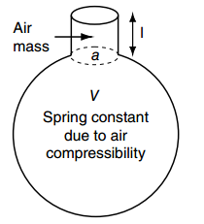
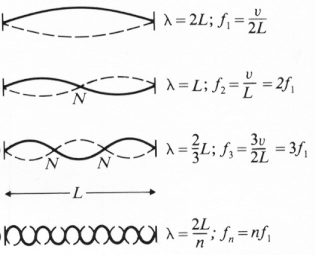
Resonance
Mass-spring system oscillates most easily at its characteristic frequency f_{res}
Helmholtz resonator: spring and mass
Vibrating string: multiple resonance frequencies
Standing wave: travels in opposite directions, reflects at both ends
Sum of waves traveling in opposite directions appears not to move
Wavelength of lowest resonance: λ = 2 x L string length
Fundamental mode frequency: f1 = v / 2L
Higher modes: fn = n·v /2L = nf1

Slide 27
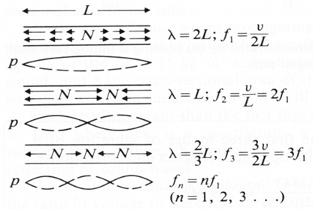
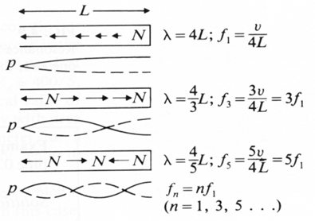
Resonance
Vibrating column of air in pipes
Reflection of the sound pulse at the end of a pipe
Reflected as negative at the open end, positive at closed end
Pipe open at both ends: Pipe closed at one end:
f_{n} = n · f₁ with n=1,2,3,.. f_{n} = n · f₁ with n=1,3,5, … only odd harmonics

Slide 28
Partials, harmonics, overtones
Terminology for discussing vibration spectra
Partial - any mode of a vibrating system
Fundamental - the first vibrating mode
Harmonics - partials that are nearly integer multiples of the fundamental
Harmonic sound - sound where partials are nearly integer multiples of the fundamental
Timbre (music)
Relative strengths of the partials determine the tone colour of the sound

Slide 29
Timbre
Frequencies of a waveform higher than the fundamental frequency.
Varies with the number, frequency and intensity of the overtones that form the waveform.
Different instruments playing same note can have different timbres:
They have different complex tones despite having same fundamental frequency.
The lowest frequency of a vibrating object, predominant frequency in a complex waveform.

Slide 30
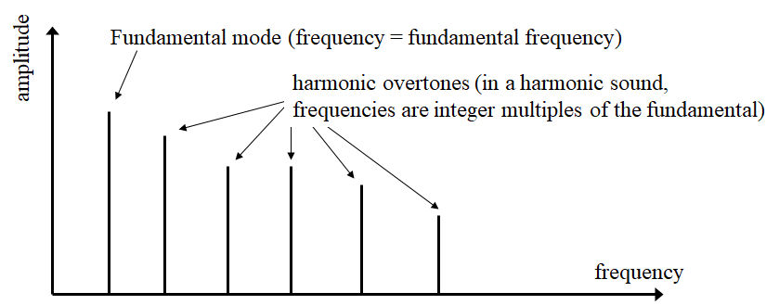
Partials, harmonics, overtones

Slide 31
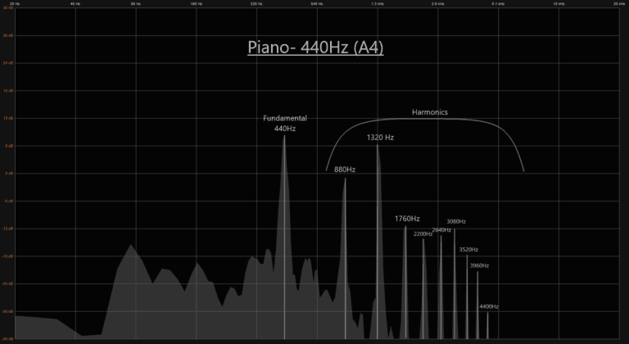
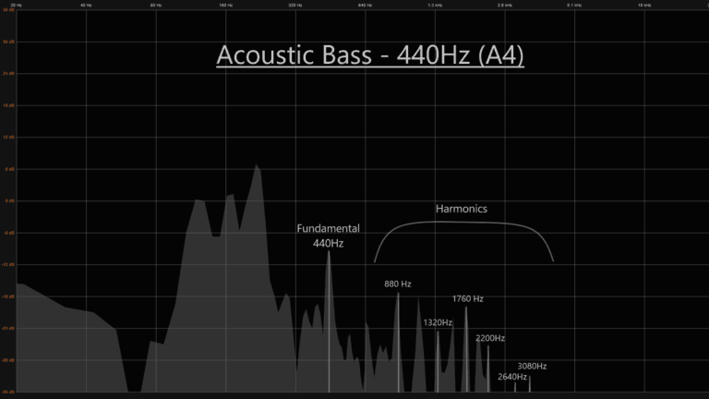
In Musical Instruments
Each instrument has its own tone or timbre → complex wave, mix of frequencies, where one stands out.
Shape and density, define the harmonic character of an instrument.
There is a difference on how loud each harmonic is in comparison to the fundamental frequency (440Hz in this example)

Slide 32
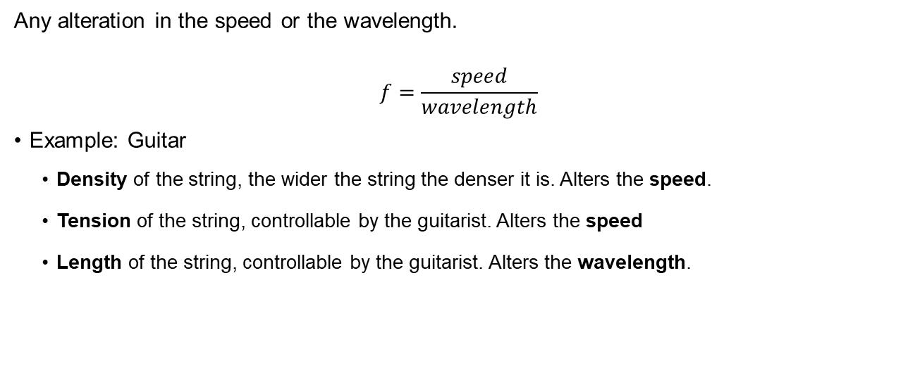
Factors that affect the natural frequency
Any alteration in the speed or the wavelength.
$$f=\frac{speed}{wavelength}$$
Example: Guitar
Density of the string, the wider the string the denser it is. Alters the speed.
Tension of the string, controllable by the guitarist. Alters the speed
Length of the string, controllable by the guitarist. Alters the wavelength.

Slide 33
Thinking break (2 min)
Think about musical instruments you know and the perspective you have now on vibration and resonance.

Slide 34
Acoustic measures and quantities

Slide 35
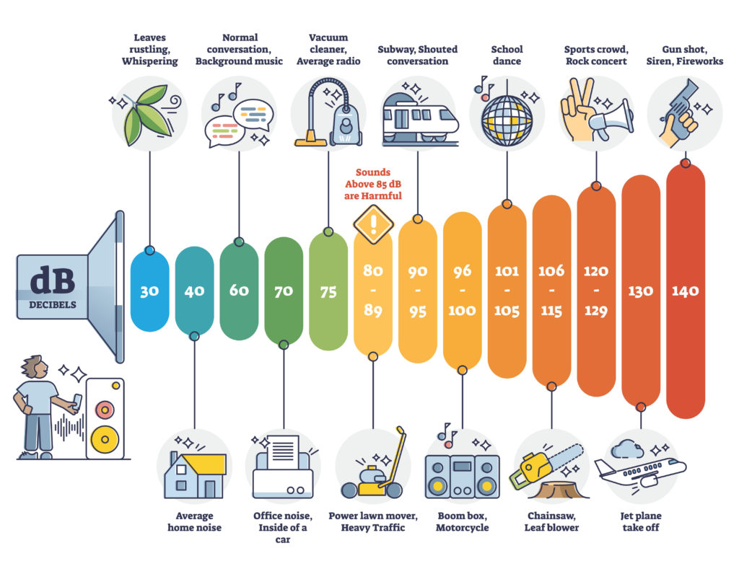
Sound level

Slide 36
Amplitude and sound levels
Amplitude: strength of the signal, larger the amplitude, the louder it will seem.
Unit to represent the strength for audio signals is decibels (dB).
Sound Intensity Level (SIL)
Sound Pressure Level (SPL)
Loudness
Sometimes used interchangeably

Slide 37
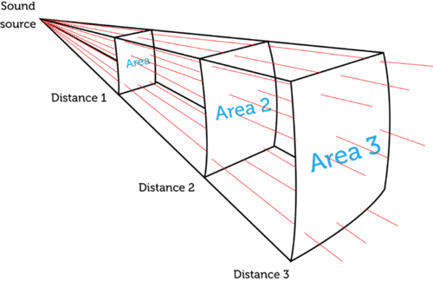
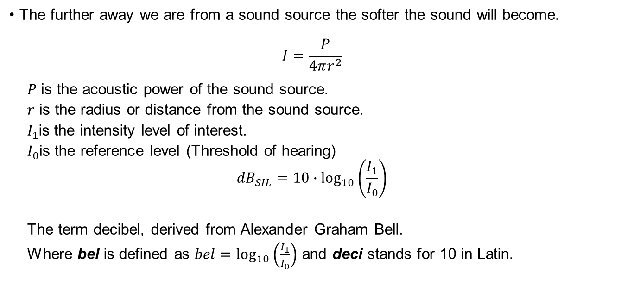
Sound Intensity Level
The further away we are from a sound source the softer the sound will become.
$$I=\frac{P}{4πr^{2}}$$
$P$ is the acoustic power of the sound source.
$r$ is the radius or distance from the sound source.
$I_{1}$is the intensity level of interest.
$I_{0}$is the reference level (Threshold of hearing)
$${dB}_{SIL}=10∙\log_{10}\left(\frac{I_{1}}{I_{0}}\right)$$
The term decibel, derived from Alexander Graham Bell.
Where bel is defined as $bel=\log_{10}\left(\frac{I_{1}}{I_{0}}\right)$ and deci stands for 10 in Latin.

Slide 38
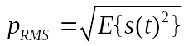
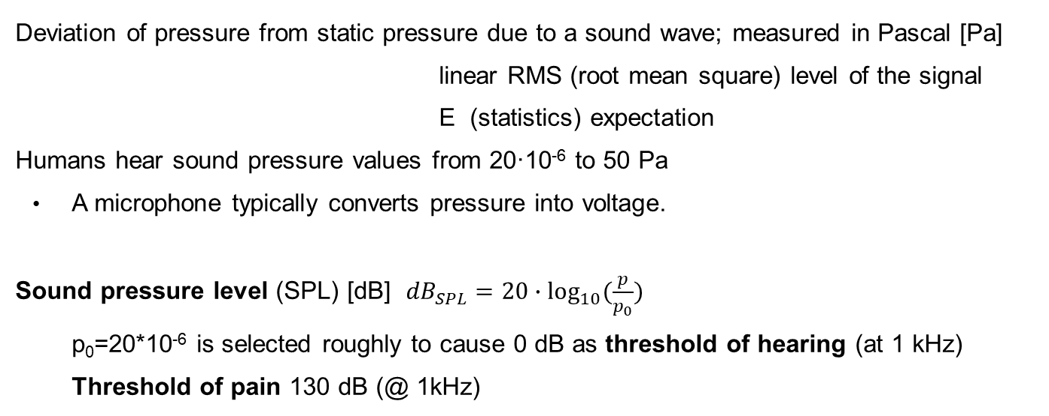
Sound Pressure Level
Deviation of pressure from static pressure due to a sound wave; measured in Pascal [Pa]
linear RMS (root mean square) level of the signal
E (statistics) expectation
Humans hear sound pressure values from 20·10⁻⁶ to 50 Pa
A microphone typically converts pressure into voltage.
Sound pressure level (SPL) [dB] ${dB}_{SPL}=20∙\log_{10}{(\frac{p}{p_{0}})}$
p₀=20*10⁻⁶ is selected roughly to cause 0 dB as threshold of hearing (at 1 kHz)
Threshold of pain 130 dB (@ 1kHz)

Slide 39
Loudness
Human perception of the magnitude of a sound.
It is very subjective: “very loud”, “moderately loud”, “soft”, …
It is dependent on the number of nerve impulses reaching the brain in a given time.
Very dependent on the frequency.
Our ears are especially sensitive to frequencies between 300Hz and 3000Hz.
More details in Lecture 3.

Slide 40
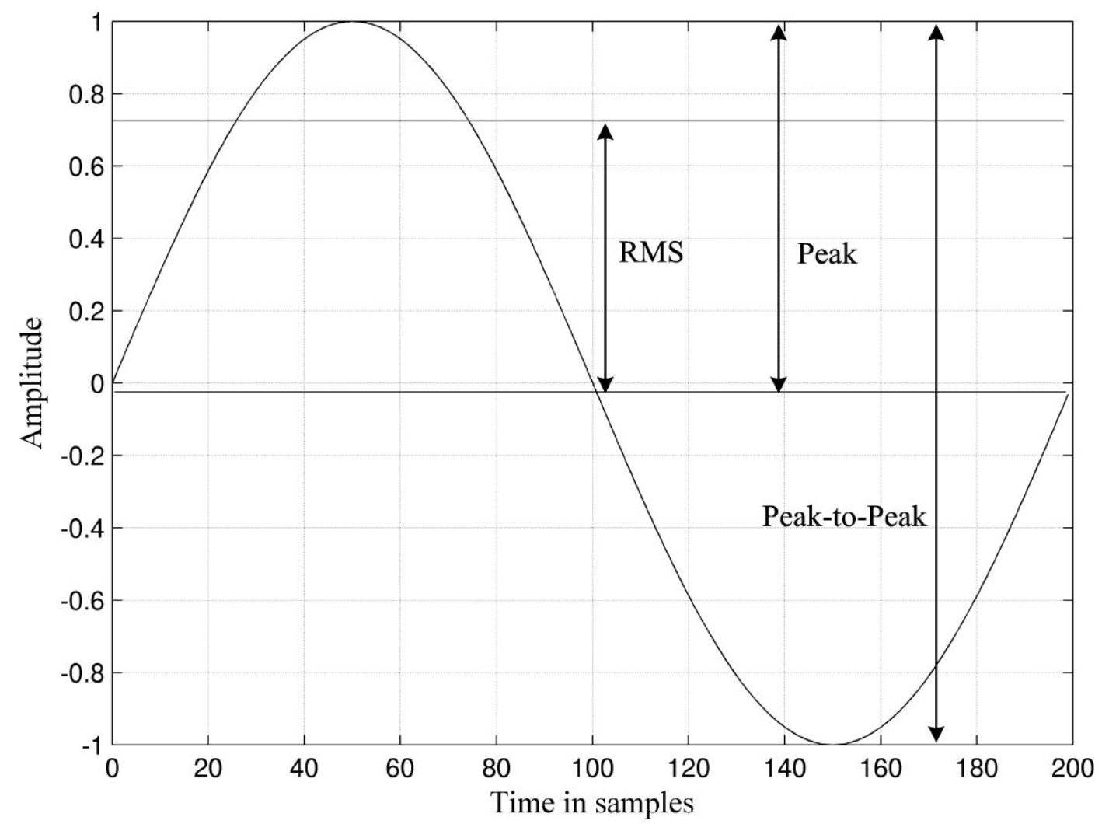
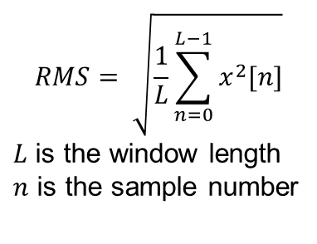
Root Mean Square
$$RMS= \sqrt{\frac{1}{L}\sum_{n=0}^{L−1}{x^{2}[n]}}$$
$L$ is the window length
$n$ is the sample number
Method used to compute the amplitude envelope of a signal. Directly related to the energy carried by the sound wave.
RMS corresponds to our hearing system’s sensitivity to the change in intensity of audio signals.

Slide 41
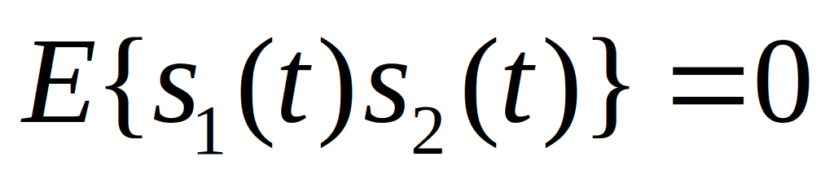
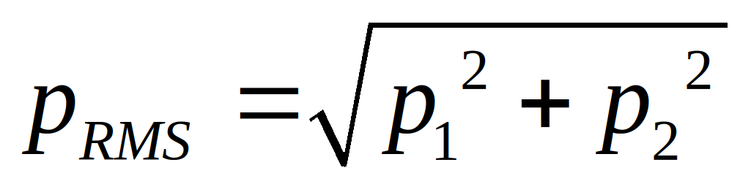
Multiple sound sources
Linear superposition of waves: sound sources sum up s(t) = s₁(t) + s₂(t)
RMS pressure level of the sum signal:
For uncorrelated signals so
If p₁ = p₂, the sound pressure level of the sum signal is 3 dB higher than that of p₁
Work out why (2 min)
(in this example, signals assumed uncorrelated)

Slide 42
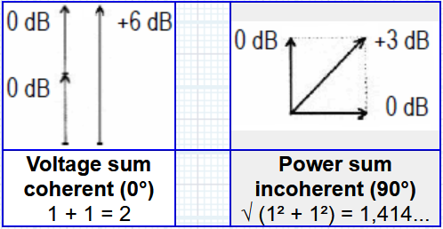
Multiple sound sources
Two sources with 80 dB sound pressure level:
Uncorrelated: results in 83 dB level
Perfectly correlated (same sound): results in 86 dB level
Same sound opposite phase: results in < 80 dB level
Doubling the sound amplitude increases the sound pressure level with 6 dB
Because
L_{p} = 20 log₁₀(2·p/p₀) = 20 log₁₀(p/p₀) + 6 [dB]
Equivalent to adding another identical source next to the first one
Intuitively: if the two sources do not correlate, the components of the two audio signals may amplify or cancel out each other, depending on their relative phases, and hence the level will be only 83 dB

Slide 43
Room acoustics

Slide 44

Sound propagation
Source far away from reflecting objects: free field
Indoor free field can be found only in an anechoic room
Spherical waves: from a spherical source (point source)
In a lossless medium, plane waves propagate without attenuation
Indoor, sound waves encounter walls and other obstacles which reflect and absorb sound in ways that determine the acoustic properties of the room

Slide 45


Room impulse response (RIR)
When sound takes place in an indoor space, there are surfaces reflecting the sound waves.
Room effect, can be created by modelling how sound propagates and reflects from surfaces, knowing the geometry of the room.
The number of early reflections increases with time, resulting in a random signal with exponential decay.

Slide 46


Measurement of room impulse response
The measurement is done by impulse excitation. E.g. Sine sweep generation
Advantages:
High sound level per frequency band
Good signal-to-noise ratio (SNR)
Room Impulse Response data set [here]

Slide 47


Direct, early and reverberant sound
Room impulse response h(t)
Direct sound: 20-200 ms depending on distance between source and listener
Early reflections: same sound reflected from surfaces,; time difference to direct sound usually under 50 ms
Reverberation: sound reflected multiple times from multiple surfaces; last group of reflections, weaker, many reflections closely grouped in time
Example:
Dry x(t) Reverb y(t)=x(t)*h(t)

Slide 48
Reverberation
A multiplicity of echoes, with too high repetition speed to be perceived as separate from one another.
Having echo is to have a delayed and diminished copy of the original audio signal.
Adding several delayed and diminished copies of the audio all together will create a reverberant audio.
This can easily achieve applying convolutions.
Echo: Greek Word (Ekho), meaning reflected sound. She was a nymph, who was cursed by the goddess Hera, so she could only repeat what others said. This happened as a punishment for her endless chatter.

Slide 49

Reverberation time
Characteristic of auditoriums and halls
Reinforces direct sound
Loss of clarity
Suitable reverb time depends of hall size and purpose (speech: short, organ music: long)
Study reverberation:
Switch on a steady source for time T
Record the sound at a different location in the auditorium
→ the level of reverberant sound increases in steps when early reflections arrive

Slide 50


Reverberation time
T60: Time where the sound level decreases by 60 dB.
Sound pressure [Pa] decreases approximately exponentially.
SPL [dB] decrease is a straight line as a function of time.
R(t) curve describing the sound level decrease can be obtained from the room impulse response:

Slide 51
Summary
Sound and vibration
How sound propagates
Properties of waves
Acoustic qualities: sound intensity and sound pressure levels
Room acoustics: reverberation

Slide 52
Extra material
Room impulse response with sine sweep
https://www.youtube.com/watch?v=azyrnyeoRkA

